Slide 1

WIPRO NGA Program – Java Full Stack 25VID1947
Capstone Project Presentation –29 Aug 2025
Project Title - Task Management System
Presented by – 30489 Susheel Prajapati
www.rpsconsulting.in

Slide 2

Introduction
The Task Management System is a full-stack project designed to help users efficiently create, update, and delete tasks.
🔹 Backend – Spring Boot with h2 database for reliable data management
🔹 Frontend – Angular for a dynamic and user-friendly interface
🔹 Containerization – Docker & Docker Compose for portable environments
🔹 Deployment – Kubernetes (Minikube) for scalable orchestration.
2025 - RPS Consulting all rights reserved

Slide 3
Spring Boot – Backend Setup
Set up a Spring Boot project for the Task Management System.
Configured Spring Data JPA with h2 database.
Implemented RESTful CRUD APIs for tasks.
Signup and Login APIs for user authentication.
2025 - RPS Consulting all rights reserved

Slide 4
Angular – Frontend Development
Initialized Angular project for UI
Built components to:
Home Page
Signup
Login
Dashboard
Add/Edit tasks
Mark tasks as complete
Delete task
Integrated Angular services with REST APIs
2025 - RPS Consulting all rights reserved

Slide 5
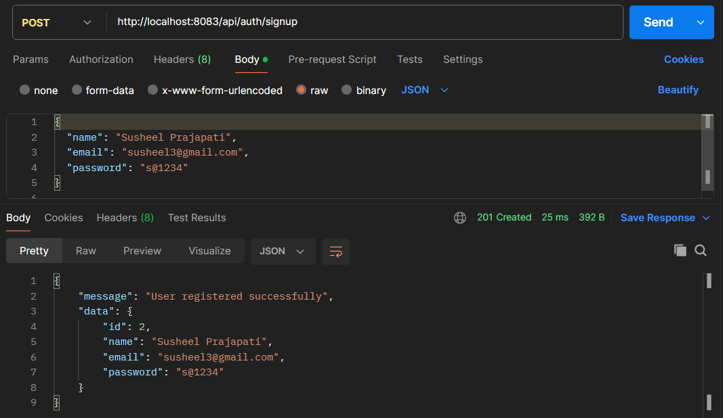
API End Points Check
User signup
2025 - RPS Consulting all rights reserved

Slide 6
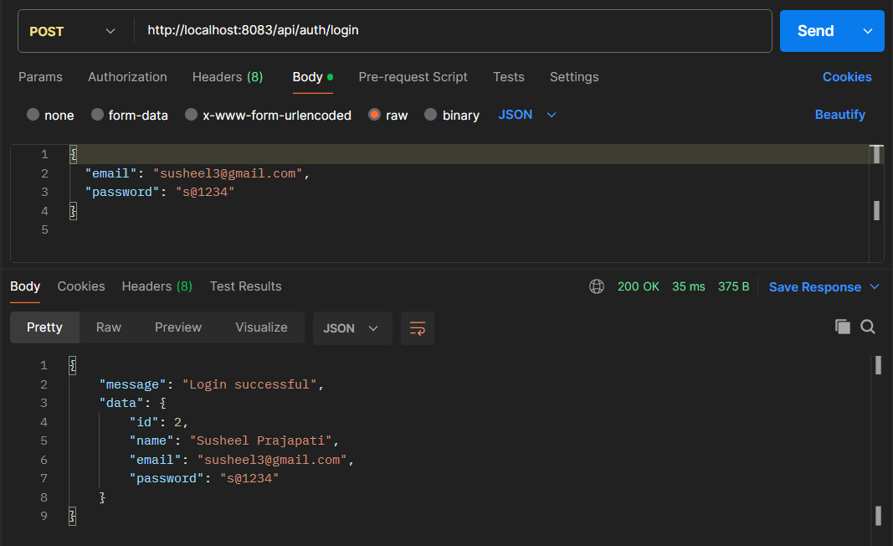
API End Points Check
User login
2025 - RPS Consulting all rights reserved

Slide 7
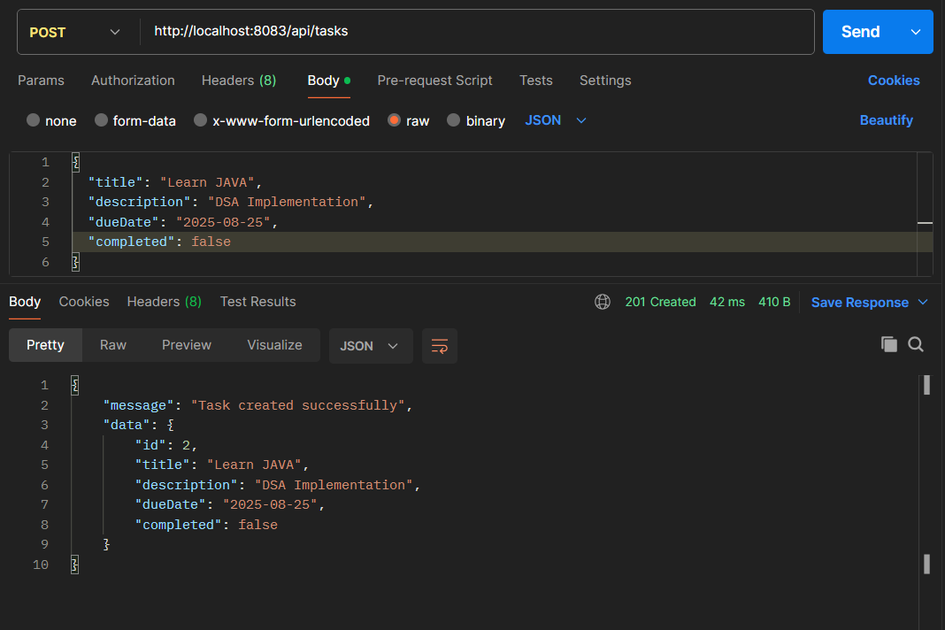
API End Points Check
Create Task
2025 - RPS Consulting all rights reserved

Slide 8
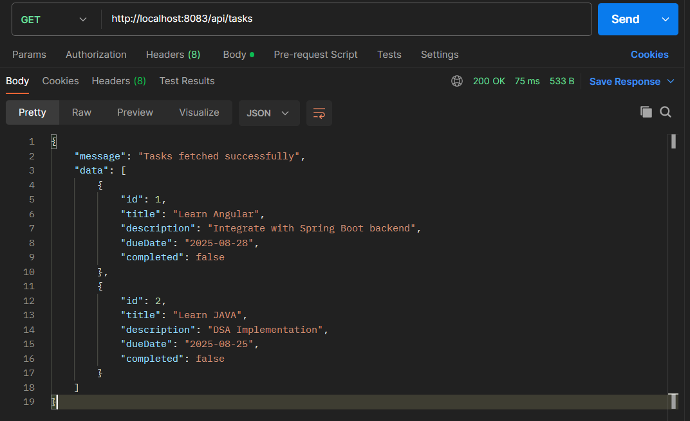
API End Points Check
Get All Tasks
2025 - RPS Consulting all rights reserved

Slide 9
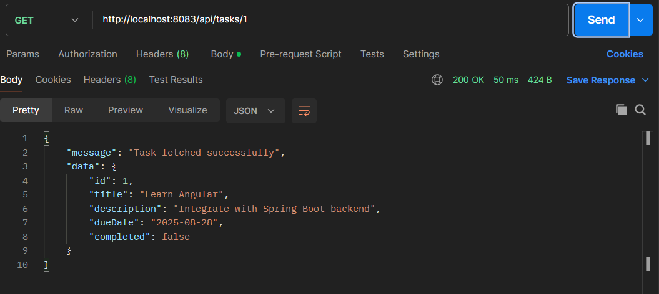
API End Points Check
Get Task By Id
2025 - RPS Consulting all rights reserved

Slide 10
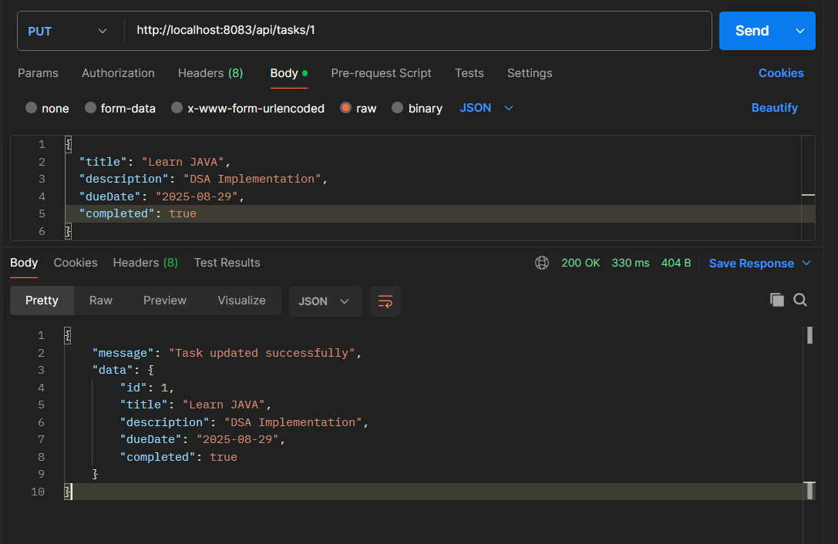
API End Points Check
Update Task By Id
2025 - RPS Consulting all rights reserved

Slide 11
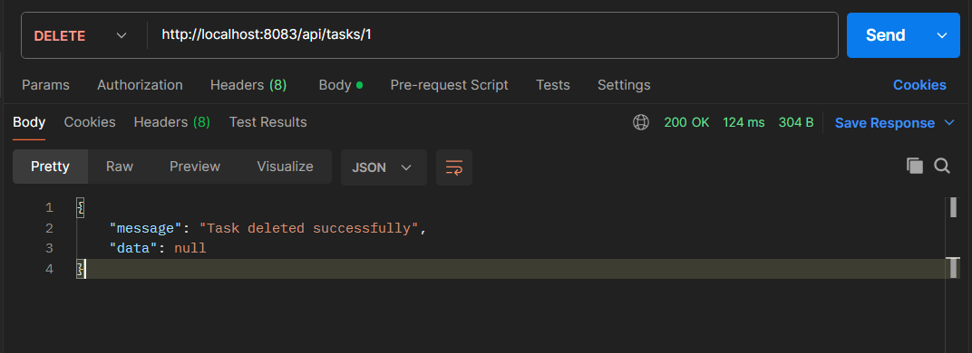
API End Points Check
Delete Task By Id
2025 - RPS Consulting all rights reserved

Slide 12
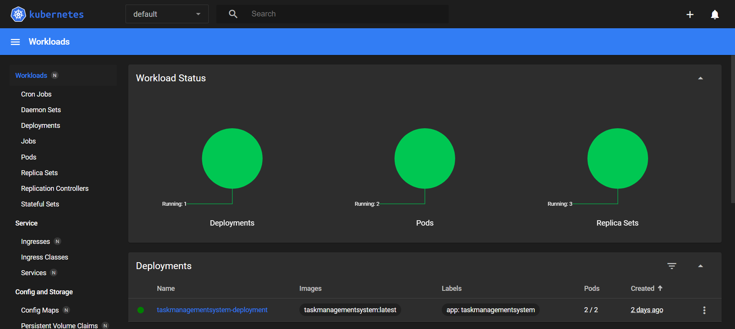
K8
Minikube Dashboard
2025 - RPS Consulting all rights reserved

Slide 13
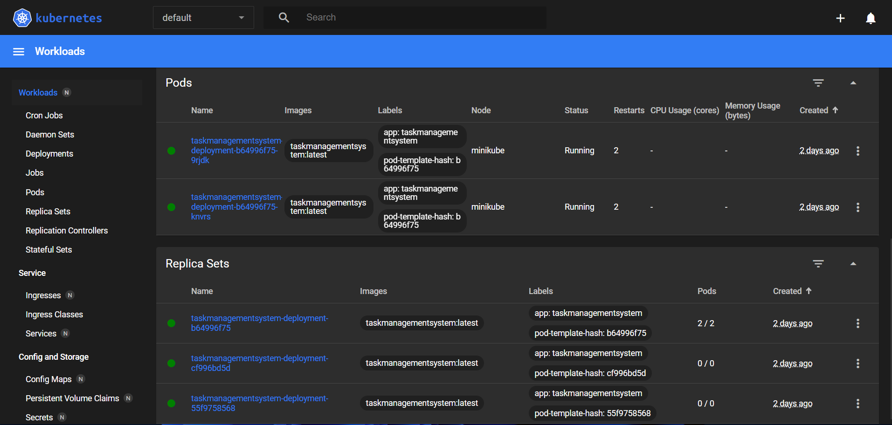
K8
Minikube Dashboard
2025 - RPS Consulting all rights reserved

